Slide 1
How to Complete the FRQ: Ap Comparative Government and Politics
Mr. Matthew Larson

Slide 2
Background
section two of AP Exam
Broken into four sections
Conceptual analysis
Quantative analysis
Comparative analysis
Argumentative essay

Slide 3
Task Words
Explain what you need to do to answer the question
Compare: Provide a description or explanation of similarities and/or differences.
Define: Provide a specific meaning for a word or concept.
Describe: Provide the relevant characteristics of a specified topic.
Develop an argument: Articulate a claim and support it with evidence.

Slide 4
Task Words
Draw a conclusion: Use available information to formulate an accurate statement that demonstrates understanding based on evidence.
Identify: Indicate or provide specific information about a specified topic, without elaboration or explanation.

Slide 5
Task Words
Explain: Provide information about how or why a relationship, pattern, position, situation, or outcome occurs, using evidence and/or reasoning.
Explain “how” typically requires analyzing the relationship, process, pattern, position, situation, or outcome
explain “why” typically requires analysis of motivations or reasons for the relationship, process, pattern, position, situation, or outcome.

Slide 6
Conceptual Analysis
assesses ability to define or describe a political concept and explain and/or compare political systems, principles, institutions, processes, policies, or behaviors.
11% of total score
Suggested time
10 minutes
Four points possible

Slide 7
Sample Question
from AP Comparative government and politics course guide, page. 163.

Slide 8
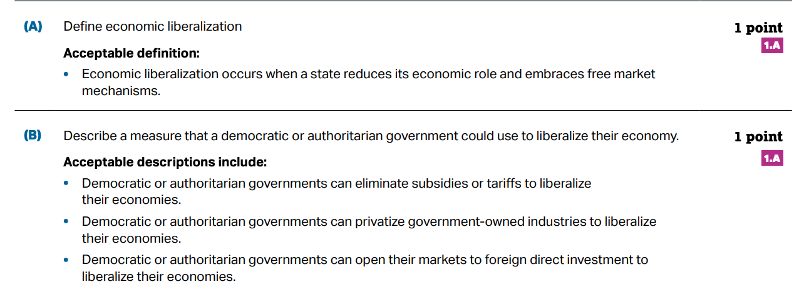
Sample Question
from AP Comparative government and politics course guide, page. 164. .

Slide 9
Sample Question
from AP Comparative government and politics course guide, page. 164. .

Slide 10
Sample Question
from AP Comparative government and politics course guide, page. 164. .

Slide 11
Quantitative Analysis
presents quantitative data in the form of a table, graph, map, or infographic.
assesses ability to …
Describe data presented
Describe a pattern, trend, similarity, or difference in the data presented
Describe relevant course concepts
Draw a conclusion based on the data and course concepts
Explain how the demonstrates political systems, principles, institutions, processes, policies, or behaviors
12.5% of total score
Suggested time
20 minutes
Five points possible

Slide 12
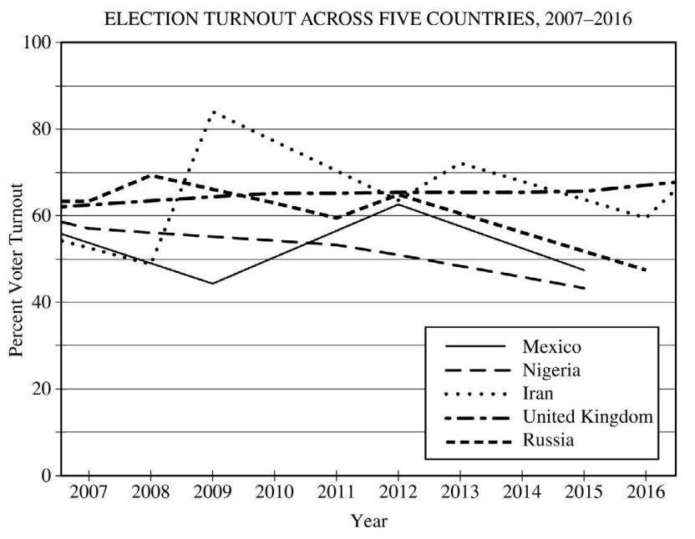
Sample Question
from AP Comparative government and politics course guide, page. 165

Slide 13
scoring
from AP Comparative government and politics course guide, page. 166.

Slide 14
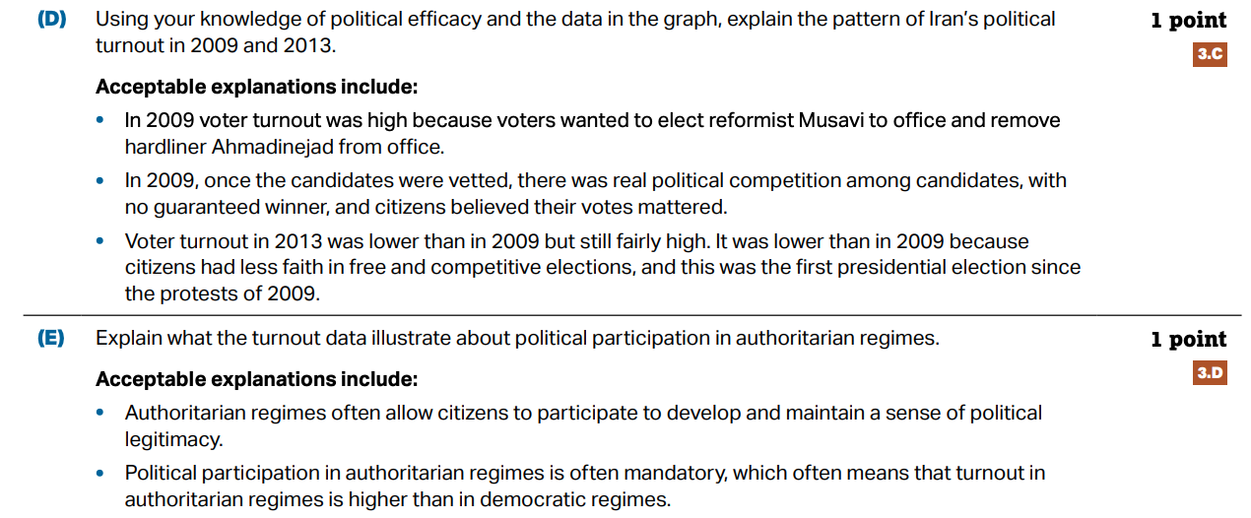
scoring
from AP Comparative government and politics course guide, page. 166.

Slide 15
Comparative Analysis
assesses ability to compare political concepts, systems, institutions, or policies in different course countries:
Define a political concept, system, institution, or policy
Describe examples of a political concept, system, institution, or policy in two different course countries
Compare or explain responses by the two course countries related to the political concept, system, institution, or policy
12.5 % of total score
Suggested time
20 Minutes
Five points possible

Slide 16
Sample Question
from AP Comparative government and politics course guide, page. 167

Slide 17
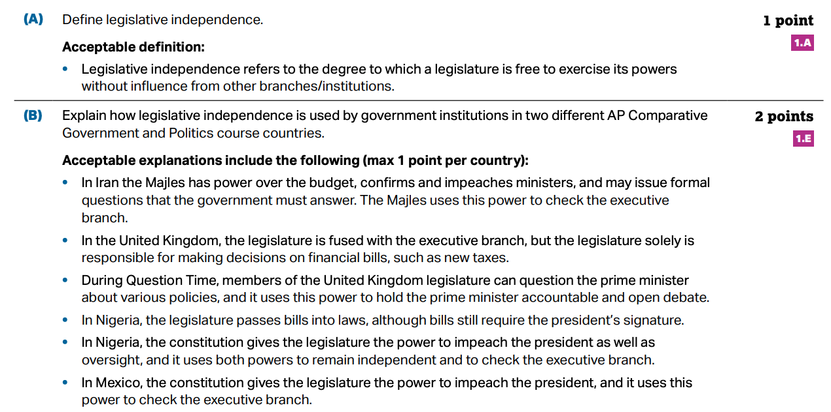
scoring
from AP Comparative government and politics course guide, page. 168.

Slide 18
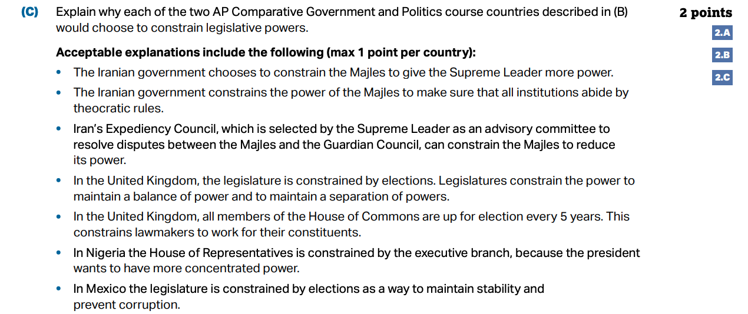
scoring
from AP Comparative government and politics course guide, page. 168.

Slide 19
Argumentative Essay
assesses ability to…
Articulate a defensible claim or thesis that responds to the question and establishes a line of reasoning
provide specific examples of evidence from one or more course countries related to the course concepts in the question prompt
Use reasoning to explain why the evidence supports the claim
Respond to an opposing or alternate perspective using refutation, concession, or rebuttal
14 % of total score
Suggested time
40 minutes
Five points possible

Slide 20
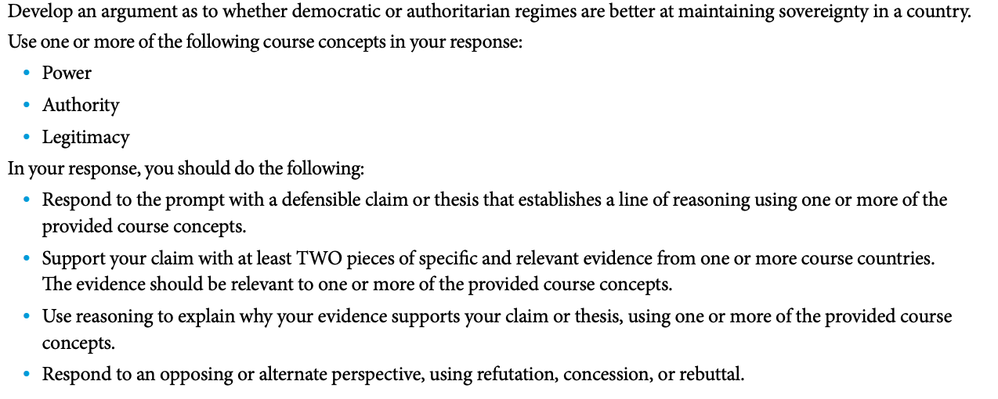
Sample Question
from AP Comparative government and politics course guide, page. 169

Slide 21
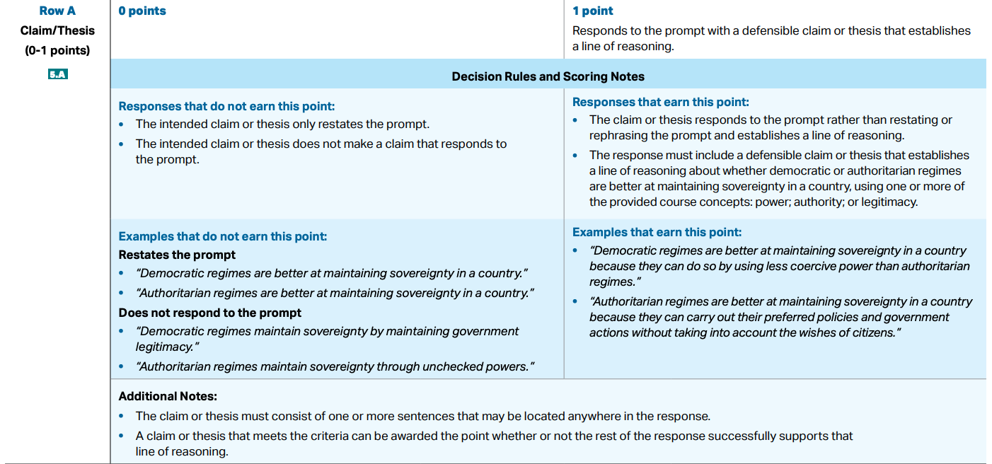
scoring
from AP Comparative government and politics course guide, page. 170.

Slide 22
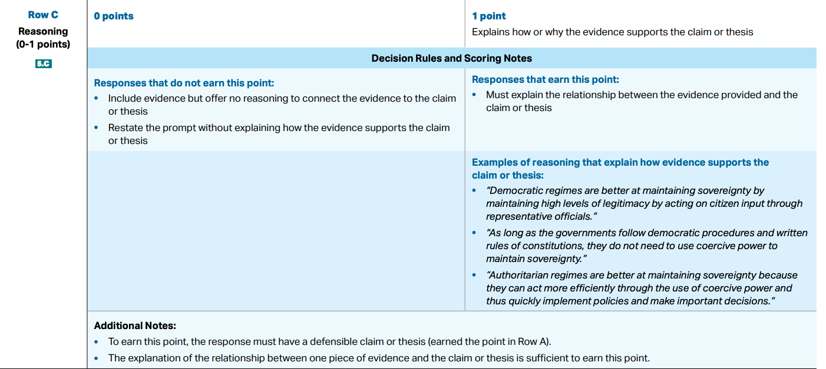
scoring
from AP Comparative government and politics course guide, page. 172.

Slide 23
scoring
from AP Comparative government and politics course guide, page. 173.

